Slide 1


Welcome Everybody

Slide 2

Rafeya Akter Happy
Assistant Teacher
A.M.Government Primary School
Hatiya,Noakhali
Class:Three
Subject:English
Lesson:My Friend
Unit:35
Time:45 minutes

Slide 3

Let’s watch the video
What is the content of the video?
Can you guess today’s lesson might be?

Slide 4
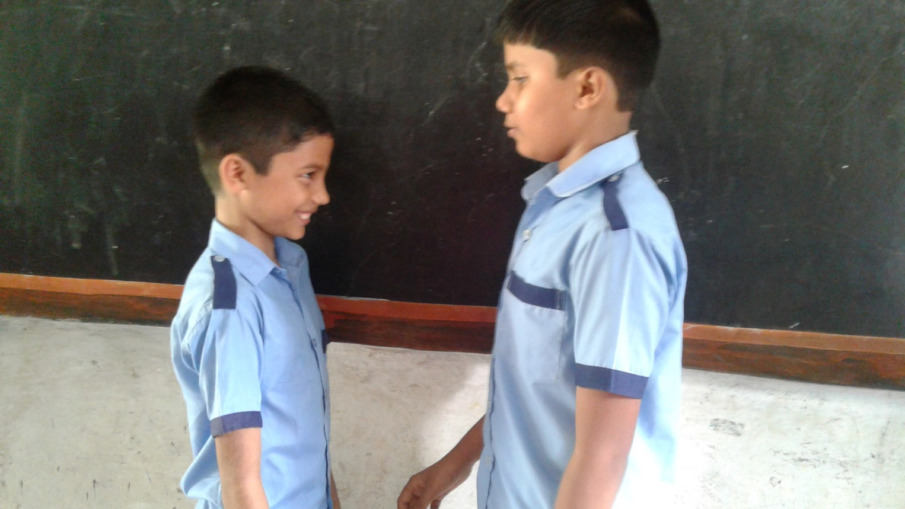

Our todays lesson is -----
My Friend

Slide 5

Learning outcomes-------
Students will be able to-----
read the texts with proper pronunciation, stress and intonation.
spelling three words and use in sentences.
write about people, objects, events etc.

Slide 6
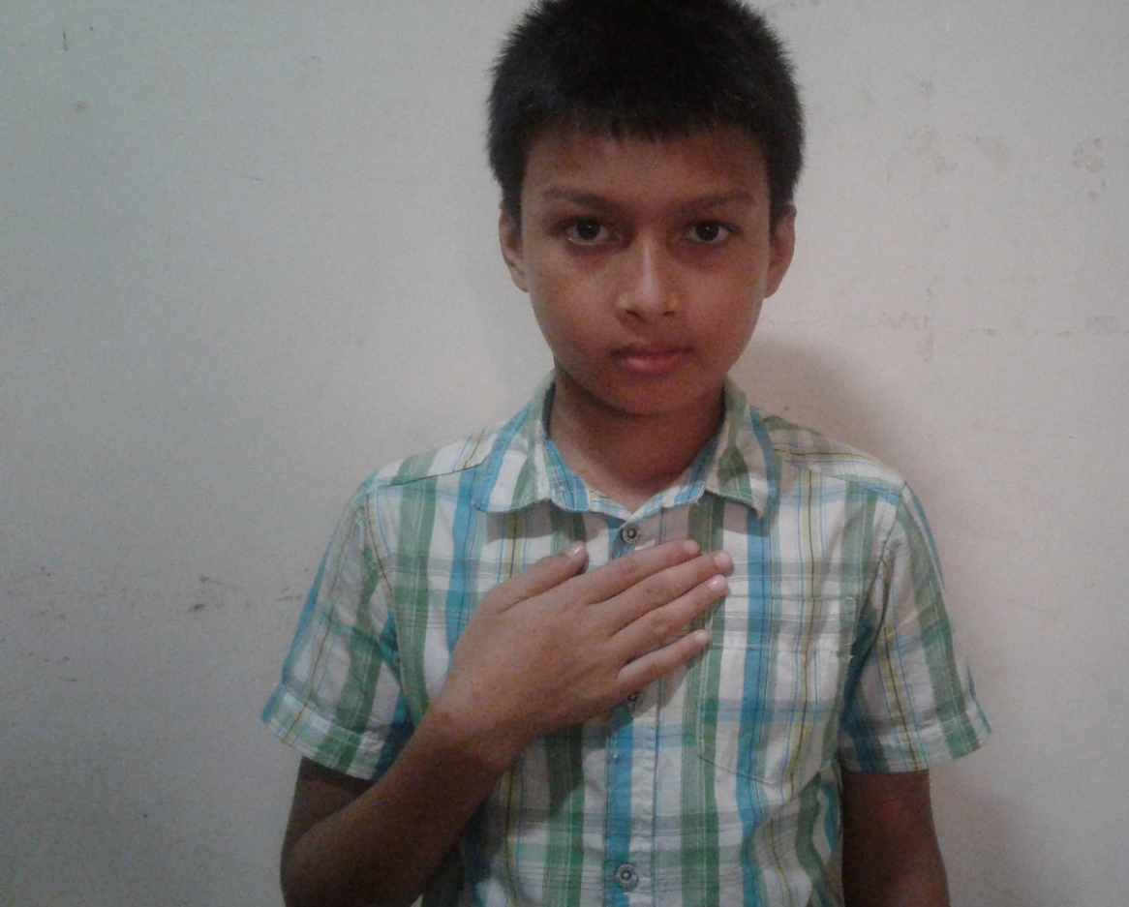
I’m Radif.

Slide 7
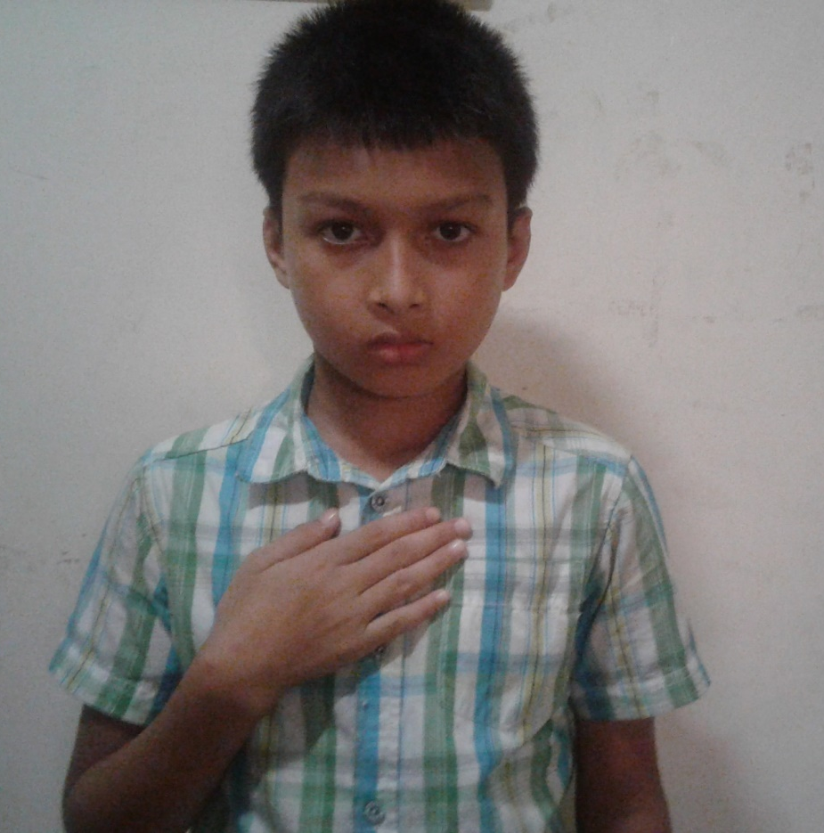
I’m eight years old.

Slide 8
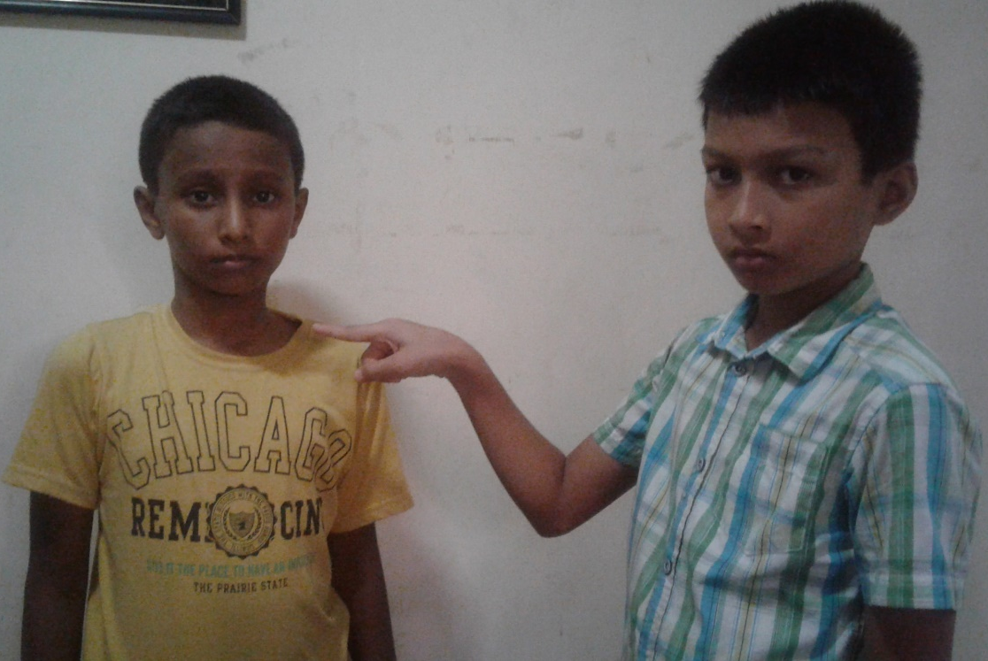
Anik is my friend.

Slide 9
He’s also eight years old.

Slide 10
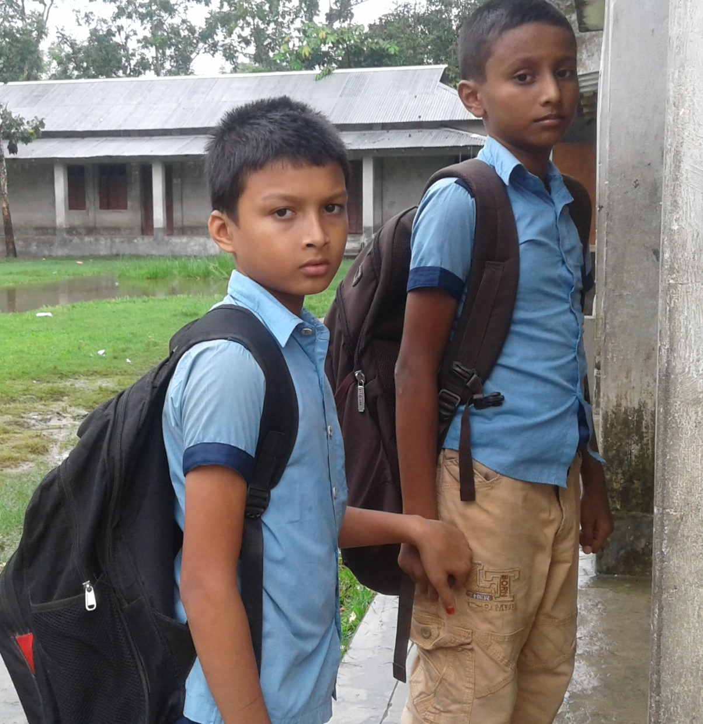
We go to Rajbari Primary School.

Slide 11
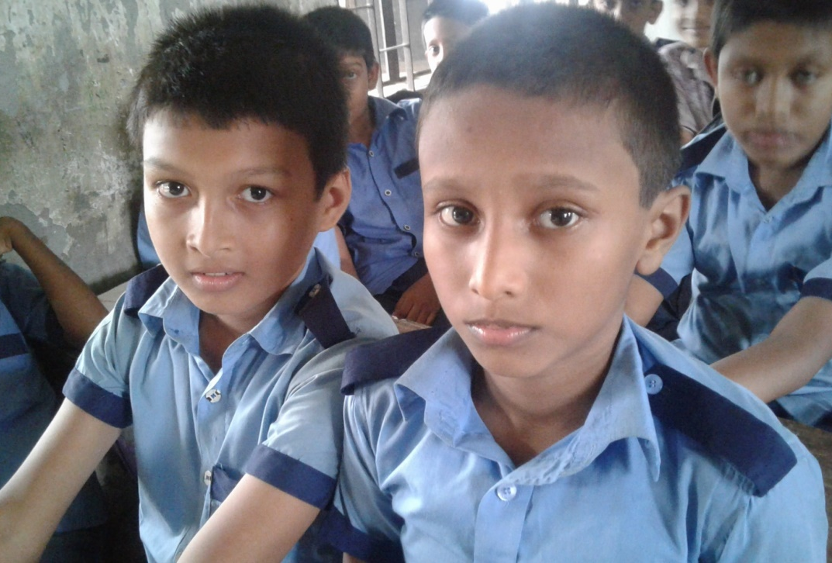
We are in the same class.

Slide 12

Anik sits next to me.

Slide 13
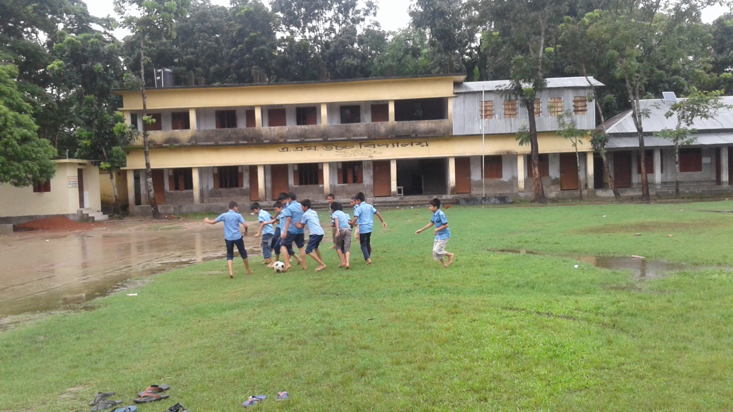
In the afternoon ,we play football.

Slide 14
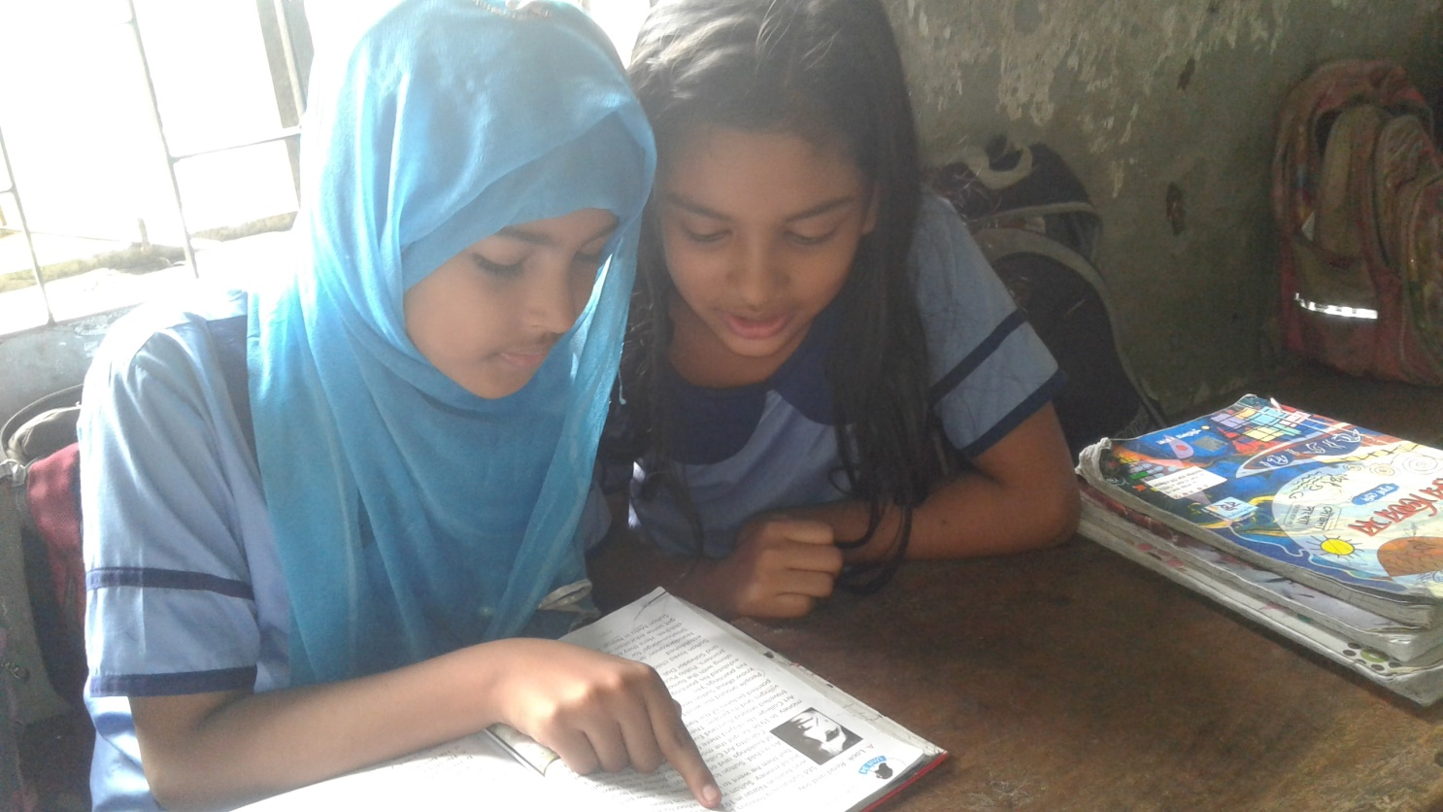
One read and another listen(pw)
Time:5 minutes

Slide 15
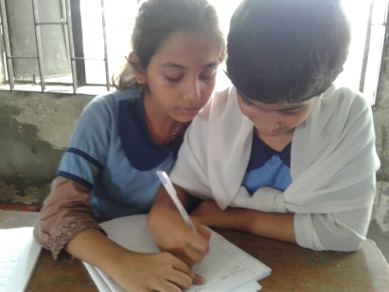


New words with sentences(by using sentences)
Same
Next
Play
Word
Meaning
Not different
We are same age.
On the first occasion after the present
She sits next to me.
Activity engaged in for enjoyment
We play together.

Slide 16
Match the words with their similar meaning(gw)
Time:5 minutes
Same on the first occasion after the present
Play not different
Next Activity engaged in for enjoyment

Slide 17
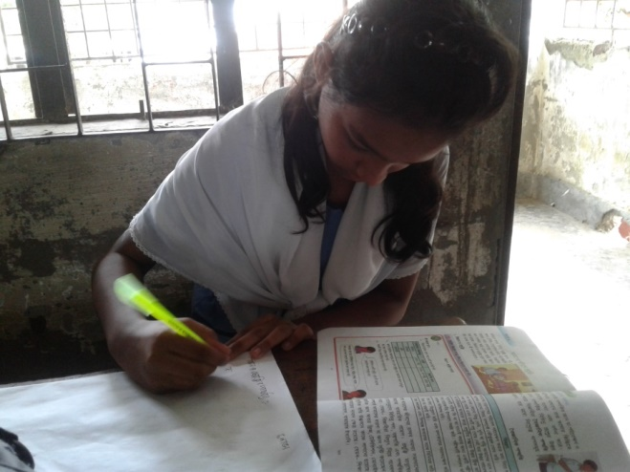
Fill in the gaps with your best friends information(iw)
Time:5 minutes
----- is my best friend.He is ----- years old.He is in class---.His favourite colour is----.

Slide 18

Let’s listen my audio

Slide 19
One read and another listen(pw)
Time:5 minutes

Slide 20
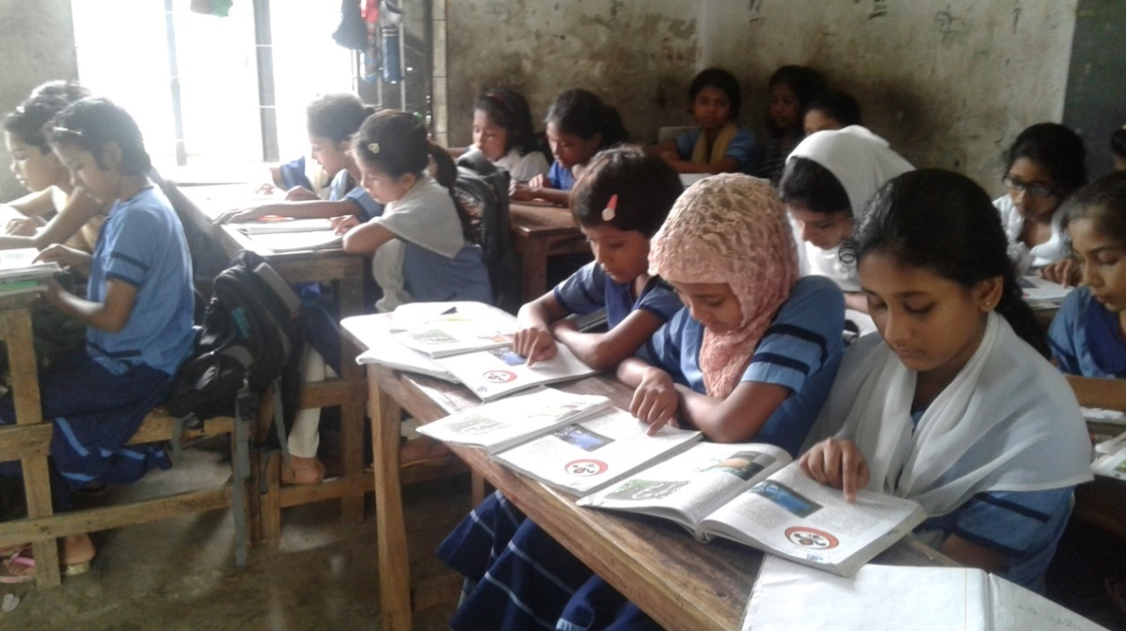
Silent Reading

Slide 21
Evaluation
Answer the questions
How old is Radif?
What is his friend’s name?
How old is Radif’s friend?
What school do they go to?
Wher does Radif sit in the class?
What do they do in the afternoon?

Slide 22


Thanks a lot
See you

